Slide 1
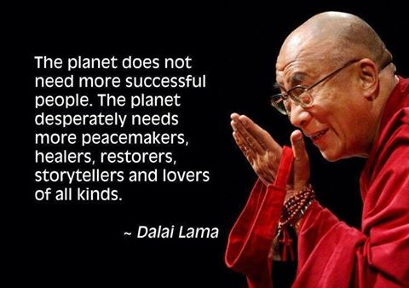
Climate Change Science and Faith
SCIO
July 2016
Oxford, UK
Randolph Haluza-DeLay
Sociology
The King’s University
Edmonton, AB
Notes:
I want to start with a methodological question before circling back in the paper to the theoretical – and metaphysical! – and back to the empirical.
Start with the story –how classify this person, so as to characterize his data in an analysis of religious people’s perspectives.
He was baptised in a United Methodist Church but didn’t know it, so as an adult was baptised Roman Catholic but now attends a Mennonite church, but not the horse&buggy, or black-bumper-automobile kinds.
In that Christian practice he leans toward a Marxist perspective – meaning “liberation theology” - but most colleagues find him “surprisingly orthodox” – especially, perhaps in terms of Biblical beliefs.
He also uses Buddhist meditation techniques.
And describes himself as having a Gaian spirituality – that is, deep ecological nature spirituality.
And this guy has thought a lot about faith-discipline integration, he sits next to a fellow social scientist in that Mennonite church – a department chair at a large research university, who admits that the faith-discipline question is not one he has thought about.
Both white, male, middle-class, well-educated, same exact church, similar ages.
So, how do you categorize those 2 people?

Slide 2
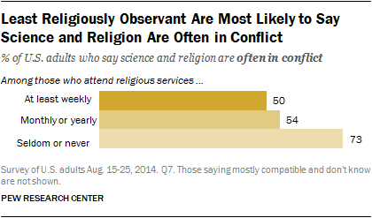
Limited Review of Lit

Slide 3
When it comes to evolution and Big Bang cosmology, what positions do different faith communities take?
Only 11% Americans belong to religions that openly reject…
Notes:
Caption for chart: “There's actually less conflict between the faith and science communities than you might think. And while there has been no shortage of controversies between the two camps—with disputes about the science curriculum in US public schools a relatively current one—only 11% of Americans belong to religions that openly reject evolution or Big Bang Cosmology. Take a look at the graph below and hover over any religion to see its position on the matter or click to see more details.” http://www.huffingtonpost.com/max-tegmark/religion-and-science-distance-between-not-as-far-as-you-think_b_2664657.html

Slide 4
Climate Change, Science, and Faith
Three Studies:
SCIO Visiting Scholar in Science and Religion, associated with Wycliffe Hall in Oxford, UK
SI: Edmontonians Talk about Faith, Science, & Climate Change
Edmonton Interfaith Centre
Ashley Fischer & Randolph Haluza-DeLay
Interviews
S2: What’s in Faith-based Climate Statements?
Randolph Haluza-DeLay & Elisa Benterud
Content analysis
Intl Society for Study of Religion, Culture & Nature
S3: Climate Communication Efficacy – survey of students @ The King’s U
Randolph Haluza-DeLay, Leanne Wilson, Katherine Hayhoe, Doug Hayoe
Survey
Slide #5
Slide #9
Slide #17

Slide 5
S1: Edmontonians Talk about Faith, Science, & Climate Change
How do Edmontonians of diverse religious backgrounds see CC and how do their understandings of their faith and science combine on this issue?
14 Interviews
Jewish (2)
Muslim (2)
Buddhist (2)
Christian (8) – Mennonite,
Anglican, Reformed, Roman Catholic, Pentecostal
Sikh (but not included in the analysis)
5 women, 9 men
Notes:
For the background of this specific report, a few years ago there was a lady who go really excited about talking about climate change with faith traditions – including interfaith dialogue. And she started an ongoing interfaith cooperation group on Climate Change – so there were meetings that were held at the Interfaith Centre for Education and Action – but even though there was interest, this group ended up dwindling – BUT still provided a pool of diverse people interested in climate change in a faith-based context
Fast forward a few years…
In the Winter of 2014 I took a class Randy, called Sociology of Science and Society and we decided to do a class research project based around Climate Change and different faith beliefs. We interviewed Edmontonians, many of which were part of those previous Edmonton Interfaith Centre meetings.
This class project ended up with 14 interviews – as you can see – of different religious backgrounds.
We used a semi-structured, “conversational” format, for the interviews
-Then we used Thematic analysis for the reporting

Slide 6
What Do Edmontonians Think? Faith & Science
Not in Conflict!
Faith & Science as Complementary
Faith & Science as Segregated
Science & Religion as Intertwined
Climate Change approached THRU SCIENCE FIRST.
Quotes on next slide…
Notes:
Interesting because what we actually see from participants is that NONE of them believed that science and religion are in conflict.
In fact, many participants’ specifically said that there is “no conflict, between science and religion” (CA2) or that “I don’t see science and religion to be in conflict” (CU6). The participants INSTEAD, found other ways to relate the two spheres.
Three approaches that we identified to explain the relationship between science and religion were them as complementary, segregated, or intertwined.

Slide 7
What Do Edmontonians Think? Faith & Science
I see science as a way to help us understand aspects of the creation and so, I see [science] as complementary to faith, not antagonistic to faith…. And I don't get caught up trying to make a book like the Bible a scientific book...
- Christian Pentecostal, male
[Science and religion] are the two arms of a body. Okay? So where the science helps me to understand the process of what is happening, the religion helps me spiritually to understand that this is my duty to do it and I have got to make that personal contribution.”
- Muslim Male
Sometimes move past each other, they mix, they reinforce each other, they carry you away sometimes, sometimes they contradict each other, but ultimately they are two currents in the same stream and mixing together and complementing each other.”
- Christian Reformed, male
Notes:
Interesting because what we actually see from participants is that NONE of them believed that science and religion are in conflict.
In fact, many participants’ specifically said that there is “no conflict, between science and religion” (CA2) or that “I don’t see science and religion to be in conflict” (CU6). The participants INSTEAD, found other ways to relate the two spheres.
Three approaches that we identified to explain the relationship between science and religion were them as complementary, segregated, or intertwined.

Slide 8
What Do Edmontonians Think? Perceptions of the Environment
Faith Traditions have different approaches
I think people are going to have to take what I would call a Christ-like attitude and say ‘okay you know I’m giving up things that I know I could enjoy but I’m doing that because I know that this is for a better good’.
Christian Mennonite, male
We look at the Buddhist teachings on just about anything – it’s about being content with what you have, not being greedy, reducing that attachment, learning how that attachment arises, how we keep it going.
Buddhist, female
Notes:
Participants also thought their faith had things to contribute towards correcting the prevelant ecological degradation.
While they mostly thought that lifestyles needed to change, there were some inter-religious differences.
For this Christian Mennonite, giving up things that someone may personally desire requires a change in a person’s attitude – specifically a christ-like attitude, as well as a change in his or her lifestyle practices.
--
The two participants that were part of the Buddhist faith discussed the importance of reducing attachment. Both participants explained that many lifestyles are often attached to material goods. This participant discussed how peoples’ negative lifestyles of greed and attachment can easily cause problems and if we lessen those attachments– which Buddhist teachings highlight – then we can come closer to solving the problems of environmental degradation, including climate change.

Slide 9
S2: What’s in Faith-based Climate Statements?
Climate Statements collected from websites and webscan
N=65; n=43
1991-present
Half of all statements = 2009 (Copenhagen), 2014, 2015
Content Analysis for Themes of interest:
Science, Justice, Hope,
Causes, Solutions, Action

Slide 10
S2: Data-Themes

Slide 11
S2: Data-Themes

Slide 12
Theme “Science”
Science gives facts
(CC really only knowable through sci)
Science predicts future
BOTH Science & religion
Both useful knowings
Complementary insights/contrasting explanations
NOMA
Science is limited
Not perfect (human institution)
Doesn’t do ethics (NOMA); tell us how to act

Slide 13
climate science
WCC: “We listened to the scientists…”
“We recognize that we do not have special training as scientists to allow us to assess the validity of climate science. We understand that all human enterprises are fraught with pride, bias, ignorance and uncertainty.” (Southern Baptist, 2008)
“As Catholic bishops, we make no independent judgment on the plausibility of "global warming.” (U.S. Catholic Bishops, 2001)
Notes:
As Catholic bishops, we make no independent judgment on the plausibility of "global warming." Rather, we accept the consensus findings of so many scientists and the conclusions of the Intergovernmental Panel on Climate Change (IPCC) as a basis for continued research and prudent action (see the sidebar: The Science of Global Climate Change). Scientists engaged in this research consistently acknowledge the difficulties of accurate measurement and forecasting. Models of measurement evolve and vary in reliability. Researchers and advocates on all sides of the issue often have stakes in policy outcomes, as do advocates of various courses of public policy. News reports can oversimplify findings or focus on controversy rather than areas of consensus. Accordingly, interpretation of scientific data and conclusions in public discussion can be difficult and contentious matters.

Slide 14
“Science limited”/ still, duty Southern Baptist 2008
Though the claims of science are neither infallible nor unanimous, they are substantial and cannot be dismissed out of hand on either scientific or theological grounds. Therefore, in the face of intense concern and guided by the biblical principle of creation stewardship, we resolve to engage this issue without any further lingering over the basic reality of the problem or our responsibility to address it. Humans must be proactive and take responsibility for our contributions to climate change-however great or small.

Slide 15
Both Science & religion – “complementary insights”
“We ask that you act with due regard for the values of both religion and science” (Canadian Interfaith, 2011)
“Religion and science provide complementary insights into the shaping of individual and collective life. Both impact choices and priorities” (Baha’i,2014)
Many scientists have concluded that the survival of human civilization is at stake. We have reached a critical juncture in our biological and social evolution. There has never been a more important time in history to bring the resources of Buddhism to bear on behalf of all living beings. The four noble truths provide a framework for diagnosing .. and formulating [a response] “ (Buddhist 2015).

Slide 16
Science and Religion – contrasting explanations…
The majority of the world’s climate scientists are unequivocal that on the external physical plane climate change is caused by… The Dharma informs us, however, that craving, aversion, and delusion within the human mind are the root causes of vast human suffering…. The Dharma offers hope by teaching us that it is possible to overcome the detrimental forces of craving, aversion, and delusion. We can use the climate crisis as a catalyst… (Hindu 2015*)

Slide 17
S3: Climate Communication Efficacy – survey of students @ The King’s U
The King’s University student body
Interdisciplinary Climate conference
Pre/Post Survey
N=319; 90% Christian (288)
Do you think that Global Warming is happening?
YES = 86.5%
Denom NOT predictor
Political Ideology IS predictor (Cons = No) (p=.003)
Yr in Prgramme – NO
Biblical Literalism – Almost! (p=.058)
Belief in Evolution IS predictor. (p=0.001)

Slide 18
Communicating climate change
Pretest
Treatment
Posttest
Belief in Climate Change
Confidence in that belief
Two day conference
Debunking myths
Belief in Climate Change
Confidence in that belief
Engendering empathy
Contextualizing in faithful ways

Slide 19
Reflections
S & R debate is popular narrative CC & R similarly narrow in popular /media
Sociology of Science:
Theory-dependence Epistemic Authority
Sociology of Religion-study religion in its complexity
Way of life vs beliefs CONTEXT! Social Practices matter!
Peter Harrison: “theological controversies waged by means of science”
Epistemic Humility: Competing notions of “the real”
Contra reductive naturalism
Methodological Advice (Research / Dialogue)
Hypothesize common ground; develop arguments treading that ground (Katherine Hayhoe – common values)
At some point, lose traction…
Note where. Agreement on explanation of WHY. (e.g., not a total rejection of Science)
Be honest about incommensurability.
Notes:
Mick Smith Quote
Epistemic humility (Keith Ward)
All is Matter (materialism)
All is Spirit (idealism)
Both Matter & Spirit (dualism? Integration?)
Matter generates Spirit (creatio)
Spirit generates Matter
Spirit & Matter are the same (monism)

Slide 20
Pretest: Belief in climate change
Notes:
Even among this highly religious sample, belief in climate change is quite high..

Slide 21
If you believe Climate change is happening…
If you believe it isn’t…

Slide 22
Factors that Correlate with belief in global warming: Political Ideology
Political Ideology
 | Believe Global Warming is happening | Deny Global Warming | Don't Know | Total
Very Liberal | 17 | 0 | 0 | 17
Moderately Liberal | 87 | 0 | 5 | 92
Neither Liberal nor Conservative | 66 | 2 | 8 | 76
Moderately Conservative | 94 | 8 | 16 | 118
Very Conservative | 12 | 3 | 1 | 16
Total | 276 | 13 | 30 | 319
Pearson Chi-Square (8) = 22.91, p=.003

Slide 23
Factors that correlate with belief in global warming: Earth’s ORIGINS
Participants who deny evolution are more likely to also deny climate change
Pearson Chi-Square (4) = 19.34, p=.001
Notes:
In fact, half of those who deny climate change also deny evolution

Slide 24
In this sample, we produced no significant effect for change in belief We did, however, move their confidence
t(69)=6.07, p=.000
Notes:
This is post-test information only. There were no responses for Not at all sure, given that these are the people who said that they believe that global warming is happening.

Slide 25
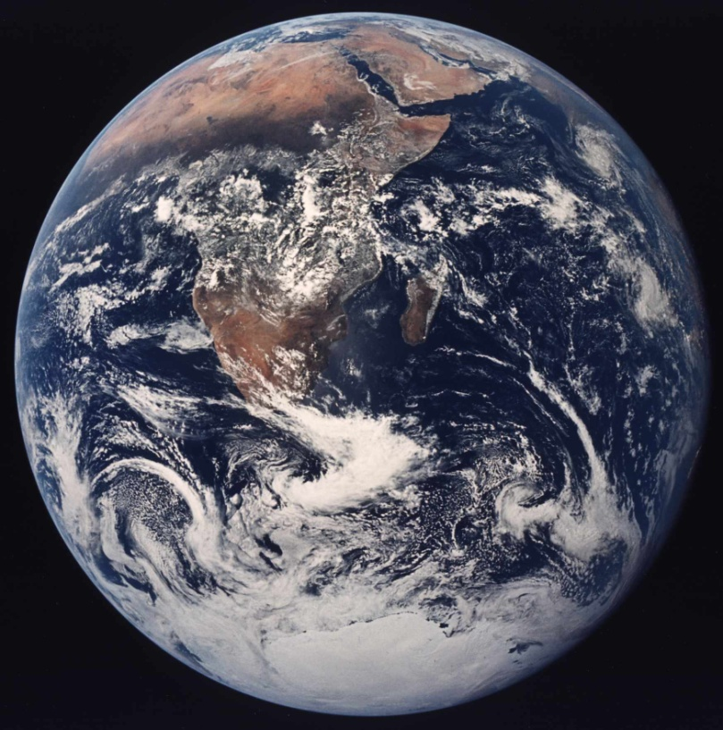
V. Conclusion
Religion needs to be studied in its complexity
Dynamics of Contention:
Religious CC Mvt is highly intra-institutional
Potentially powerful, resourced, reach, but culturally entrenched
Frame Bridging to other Justice Movements
MUCH BASIC RESEARCH NECESSARY
Conditions of conservative, progressive
Operations in the Post-secular?
(analysis of longterm responses, e.g., to encyclical)
Nature + Religion + Political Theology =
Political Ecology in action?

Slide 26
There is lots of qualitative data to analyze: like thESE…

